Slide 1

NEHA ENTERPRISES
Works: Plot no B14/10/09, Near COSMO FILMS, MIDC, Waluj,
Ch.Sambhajinagar (M.S)-431136 (India).
Cell- +91-9822791544. Email- nehaenterprises157@gmail.com
SUB: Company profile and Products of Neha Enterprises.
Dear Sir,
We have 32 years experience in Machine building and automation field.
As following are our firm details
NAME OF THE COMPANY: M/S Neha Enterprises.
OFFICE & WORKS ADDRESS: Plot no B14/10/09, Near Cosmo films, Colgate chouk,MIDC, Waluj,Ch.Sambhajinagar.
Total area= 6000 Sq/Feet
Building area= 1000 Sq/Feet
Total Employees - 6 Nos.
Designer - 2 engineers (Auto-CAD and Pro-E)
Supervisor – 1 engineer
Workmen's - 3 ITI
Annual turnover – 50 Lacks
Available machines-
Universal milling machine with jib boring facility with DRO.(Imported)
5.5 feet Lathe machine.
Surface grinder. (350 x 550)
Bosch Cutting machine.
Welding machine
1” drilling machine
We have all necessary inspection instruments.

Slide 2
Our Expertise and Products
01. Aluminum profile structures
Structures in Aluminum profile.
Material handling trolleys, Conveyors and SPM structures in Aluminum profiles.
02. Automations, Machine Building and Fixture Designing
Assembly automation, Pick and place units,Poka yoke system, one piece dispensers, Rotary feeders , Belt and Gravity conveyors and Fixture design work in CREO and AutoCAD.
03. SPM’S
Various types spm’s, Vision systems, Press Automation, ID and OD measurements Systems, Measurement systems, IOT based projects etc.
04. Retrofitting of machines-
All types of electrical wiring work , PLC programming work and retrofitting of old electrical panels with using new technology to minimize the breakdown and improve functions.
05. We have repairing facility of Electronic Instruments and PCB Cards.
For any query or any more information you may contact us.
We are sure you are bound to get the full satisfaction in respect of quality, price and suitability of the products we supply.
Thanking you.
For Neha Enterprises
DC Choudhari.
9822791544

Slide 3
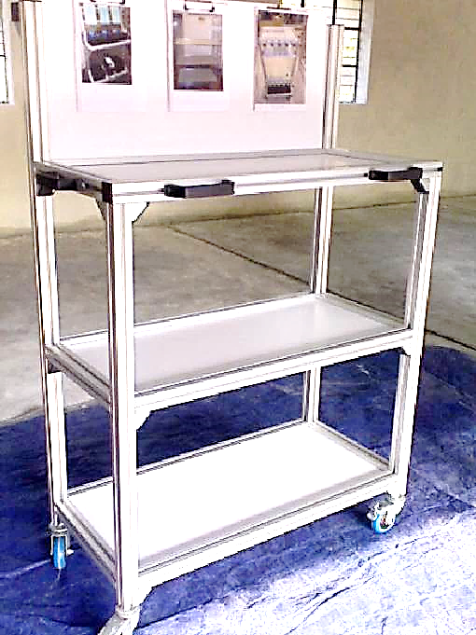
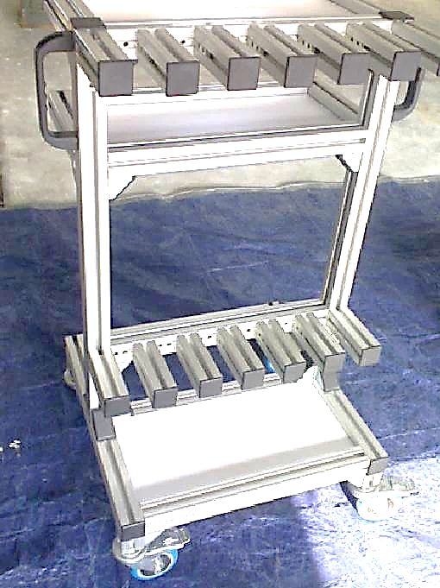
Aluminium Profile Trolley
Aluminium Profile Tool Trolley

Slide 4
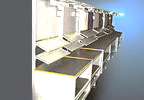
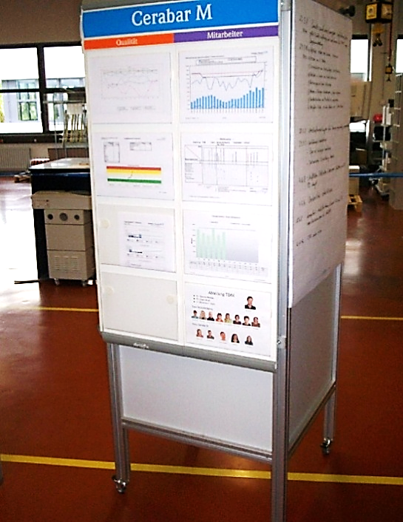
Work Station Table
5S Display Board

Slide 5
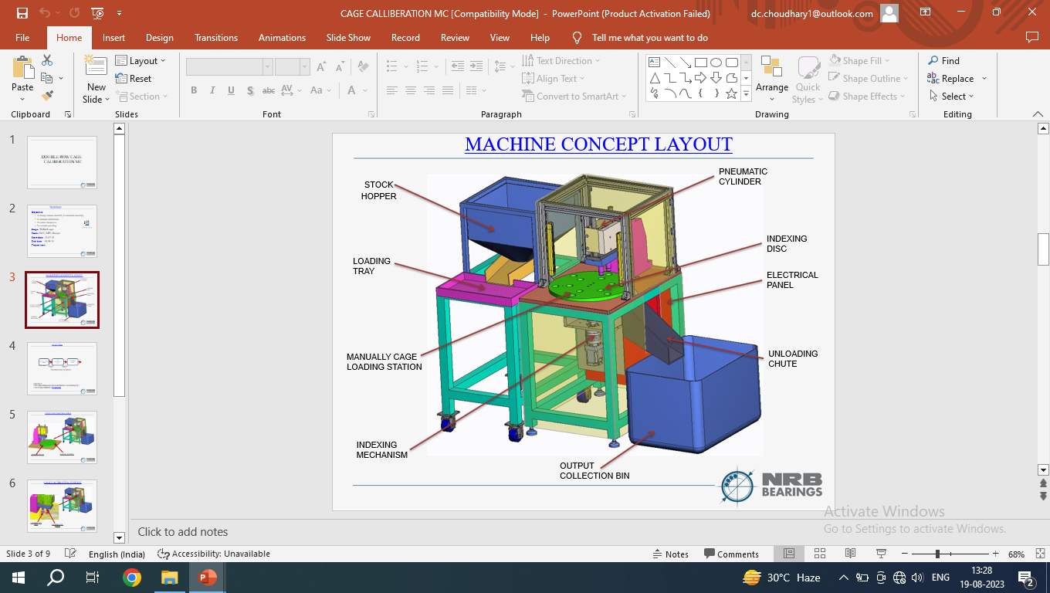
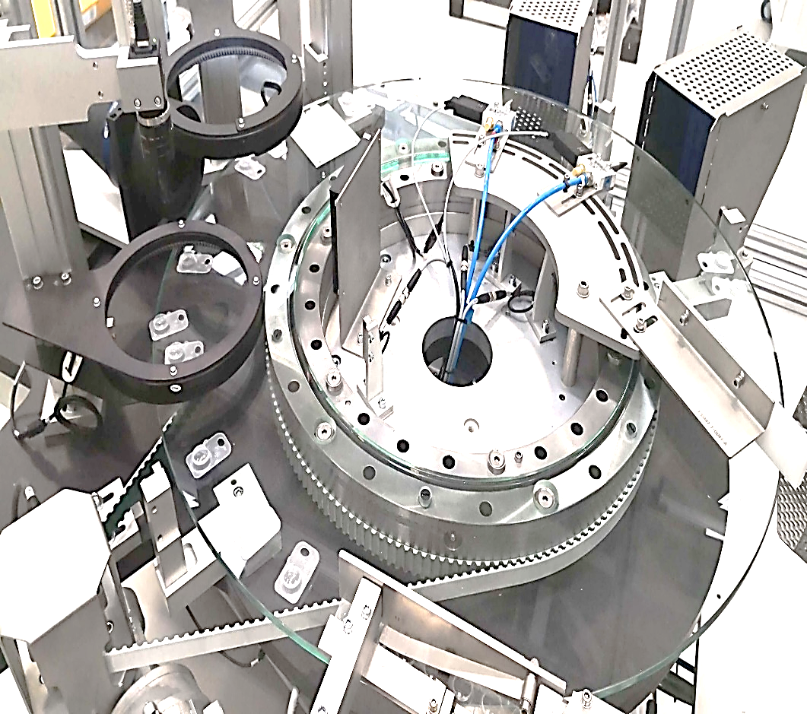
Indexing Type Fully Auto Assembly Machine
Machine Vision System

Slide 6
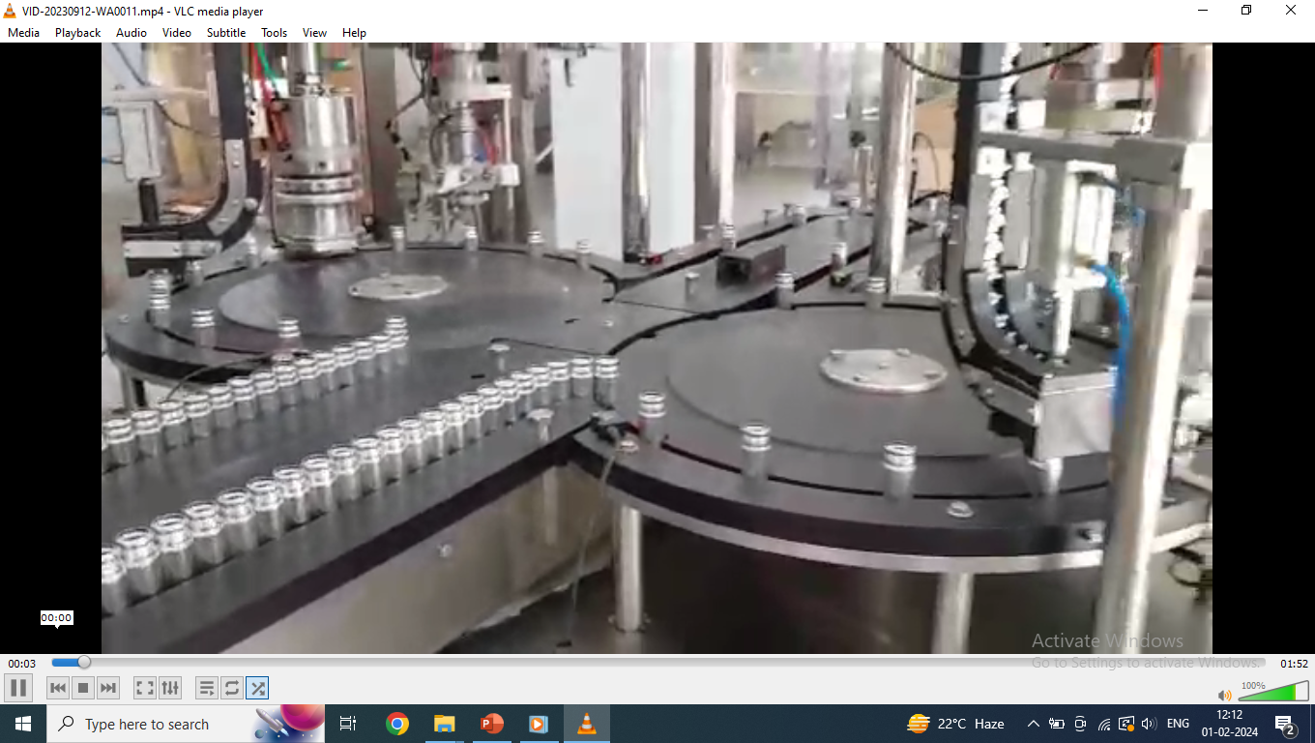
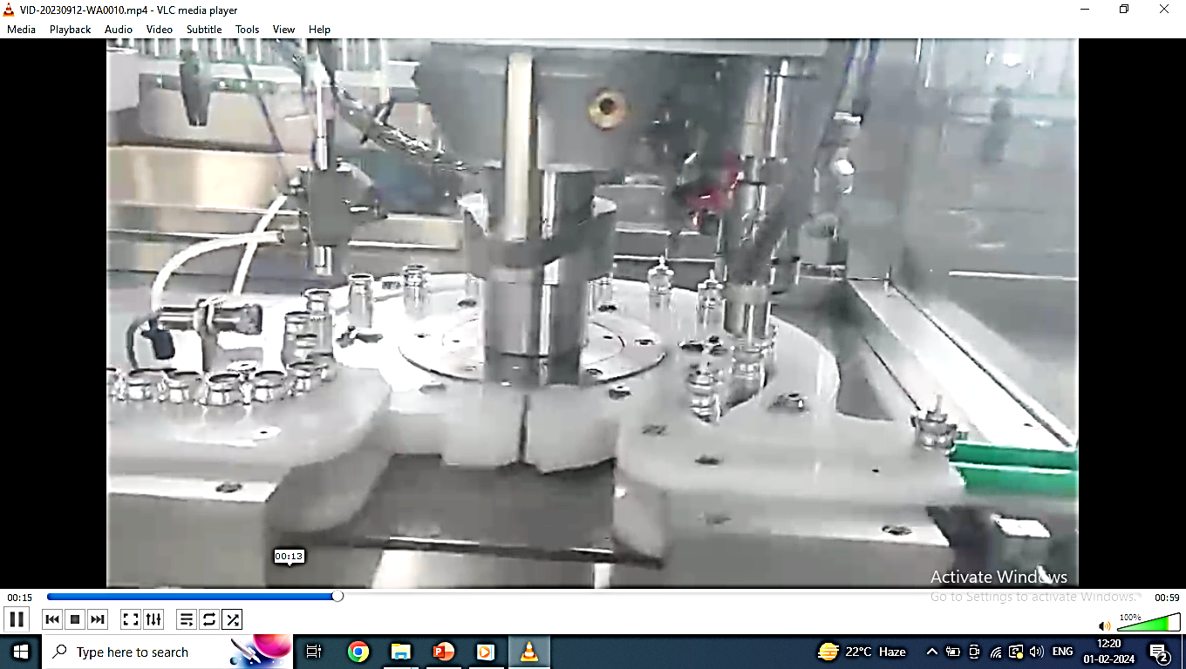
Indexing Type Fully Auto Assembly Machine
Indexing Type Fully Auto Assembly Machine

Slide 7
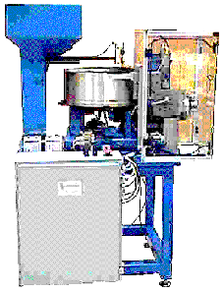
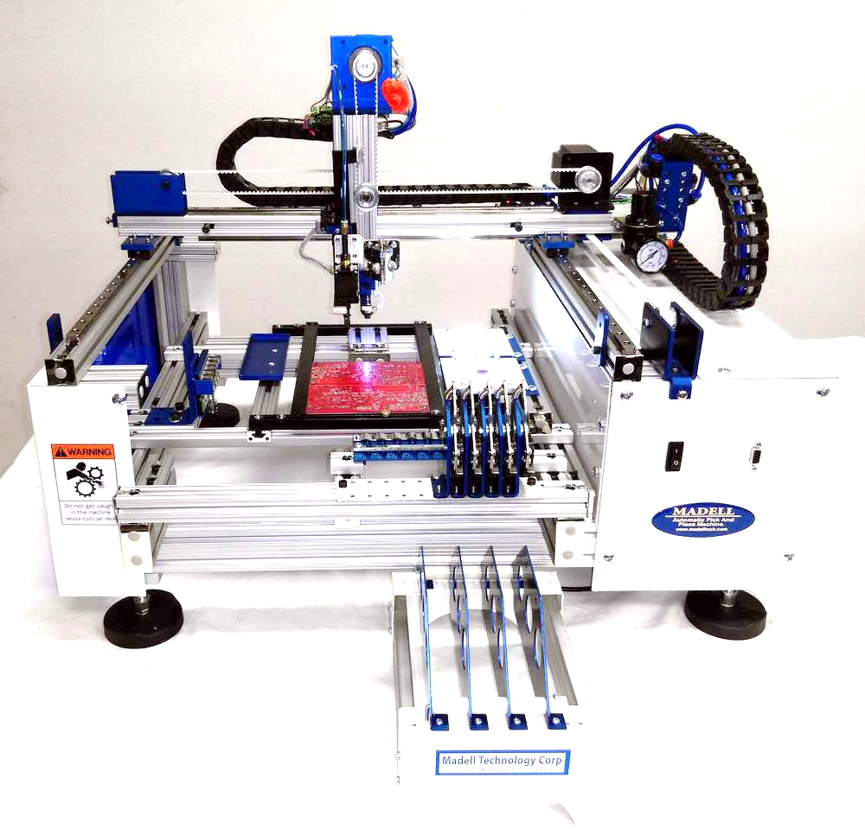
Fully Auto Inner, Outer Diameter and Width Measurement Machine
Pick And Place System

Slide 8
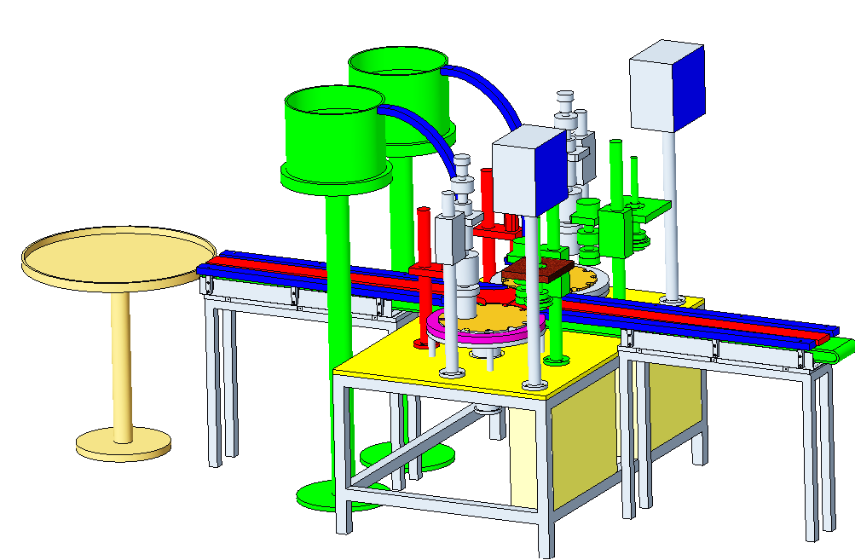
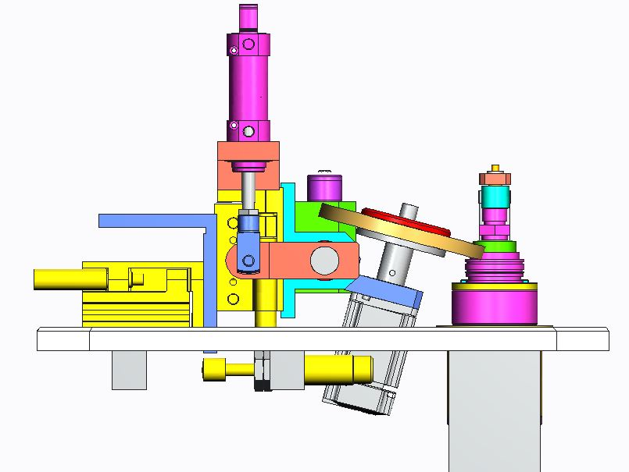
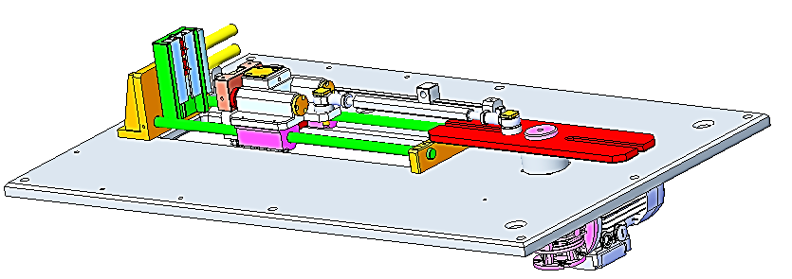
Special Purpose Machine Design and Manufacturing

Slide 9
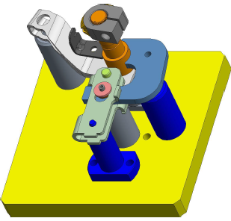
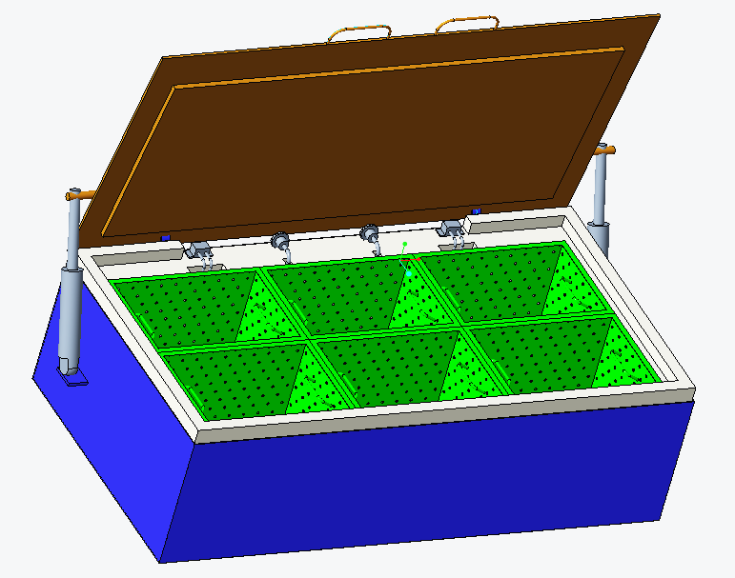
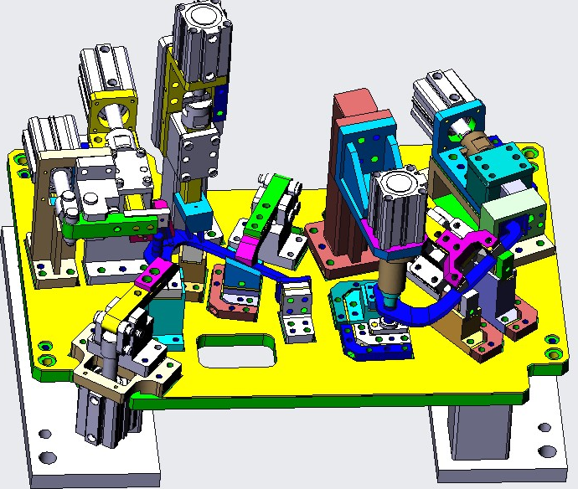
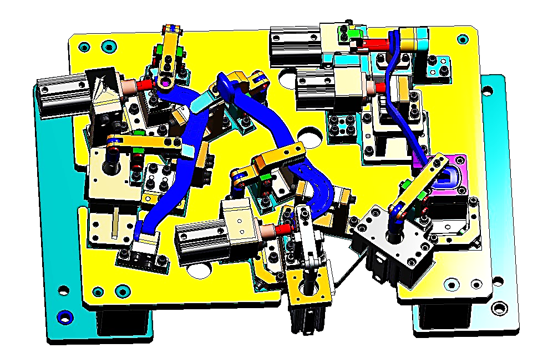
Fixture Designing and Manufacturing

Slide 10
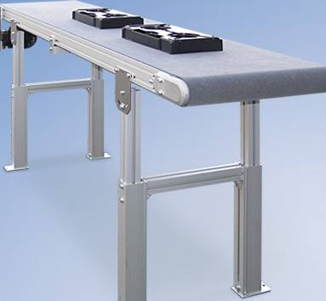
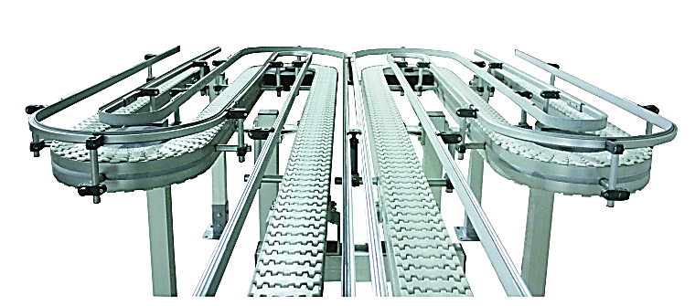
Flat Belt conveyor
Flex link Belt Conveyor

Slide 11
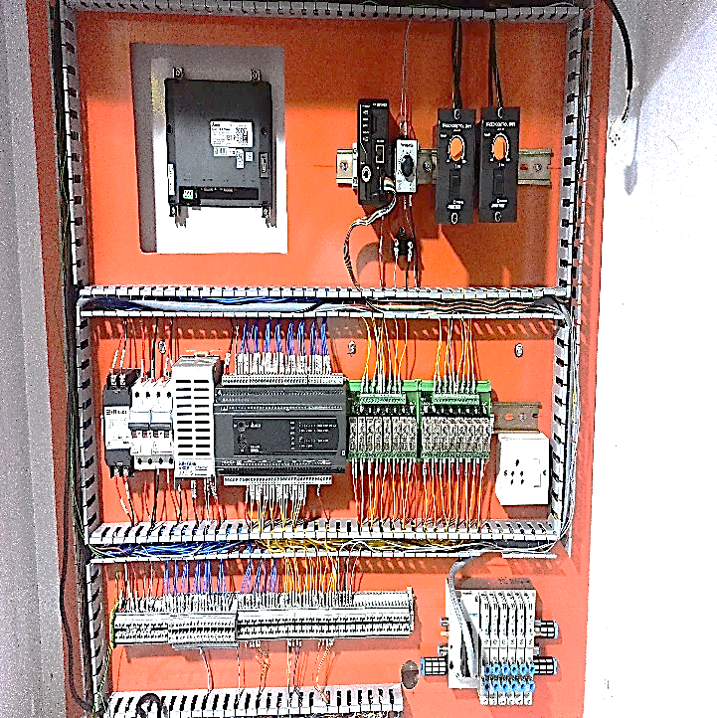
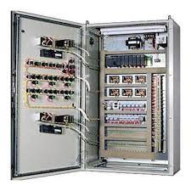
Electrical Panel
Electrical Panel Design and Devlopment

Slide 12
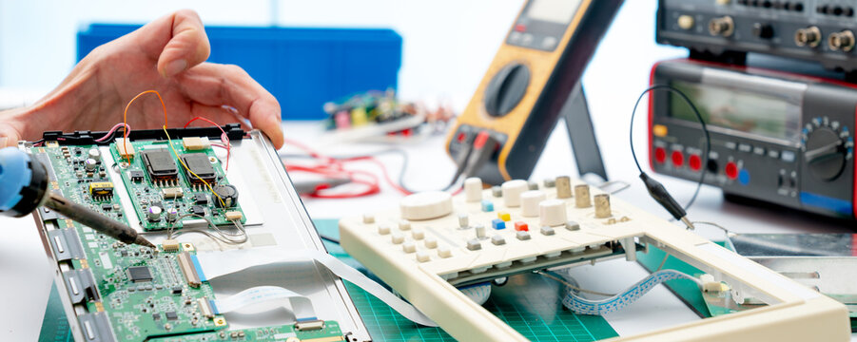
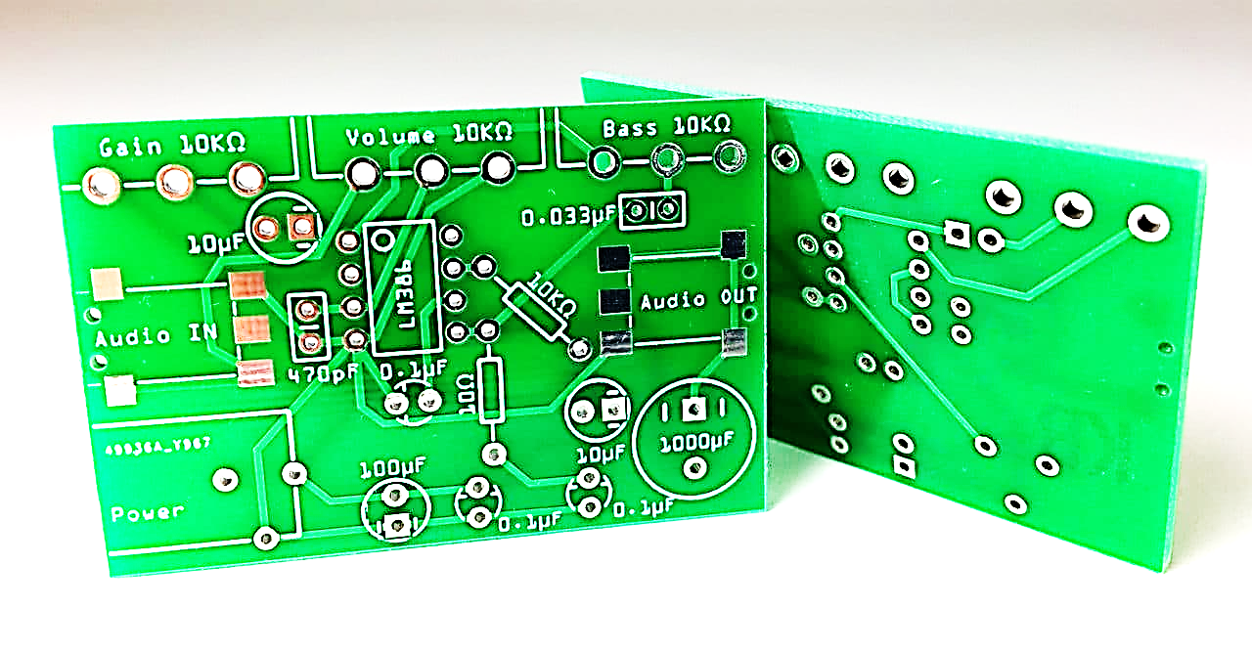
All Types Of Electronic Instruments Reparing Facility
PCB Design,Repairs and Devlopment As Per Requirement

Slide 13
Followings are our valued customers-
Endress+Hauser (India) Automation Instrumentation Pvt Ltd.
Endress+Hauser (India) Flow-tec Pvt Ltd.
Siemens Limited.
Midas care Pharmaceuticals pvt Ltd.
Sterlite Limited.
THANK YOU

